Slide 1
DS5220 - SUPERVISED MACHINE LEARNING
FINAL PROJECT - US AIRLINES TWITTER SENTIMENT ANALYSIS
TEAM MEMBERS:-
NITHISH GOUD PODETI
VARSHA REDDY ANUGU
SUJITH NAARAYAN HIRENDRA BABU

Slide 2
TOPICS :-
Introduction
Feature Selection and Preprocessing
Models
Experiments and Evaluation
Results

Slide 3
INTRODUCTION:-
The dataset that we have chosen for this project is “US AIRLINES TWITTER SENTIMENT ANALYSIS”.
As you know, air travel is a tiring process. Any traveller wants to travel in a better flight, for which they search for the reviews on any social media platform. The analysis based on the reviews makes it easier for both traveller and the airline to decide on the changes to be made respectively.
In this project, we are going to analyse how travellers in various airlines have expressed their experience through tweets on Twitter. Different feedbacks have been given based on which sentiment analysis can be performed.
The purpose is to create a model which on providing the tweets(reviews) to the training should provide the outcomes that whether a particular tweet done by an individual is a positive response or a negative one or neutral.
All reviews that depict positive response contains good experience with the traveller with the airlines.
All reviews that depict negative response contains difficulties faced by travellers.
Neutral Responses will be, that which are not specific to be considered in positive or negative.
This will help the airline find out their deficiencies so that they could work on it.

Slide 4
DATA:-
The dataset that we have used in the project provides information about travellers tweets for the US Airlines and the source is obtained from kaggle and the link is shared below :
https://www.kaggle.com/crowdflower/twitter-airline-sentiment.
The dataset consists of 13 columns and 14,000 rows.
The main parameters that the dataset includes are as follows:-
-> The Tweet Id
-> Airline Sentiment
-> Negative Reason
-> Airline
-> Tweet

Slide 5
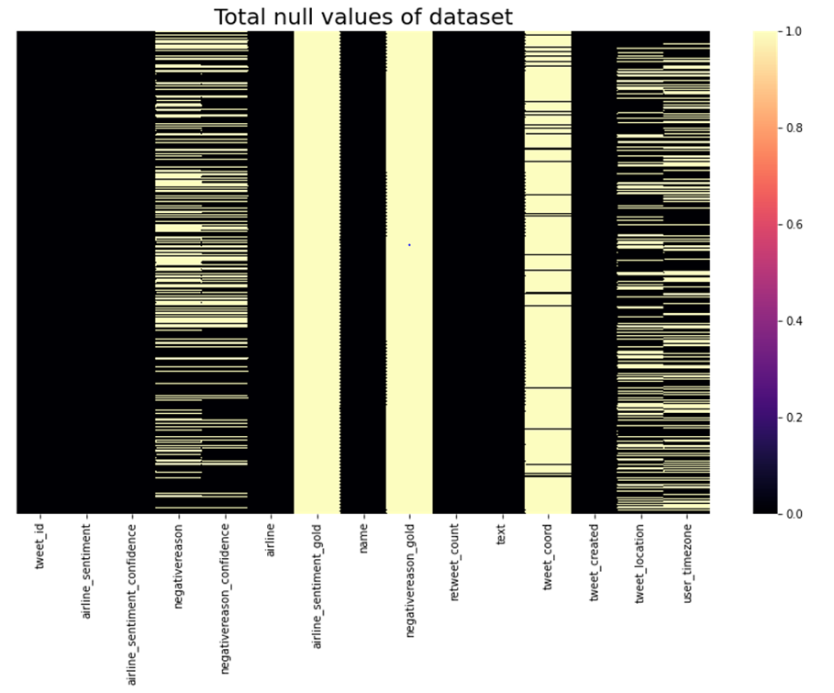
EXPLAINING THE DATASET VISUALLY:-
Total null values of the dataset.

Slide 6
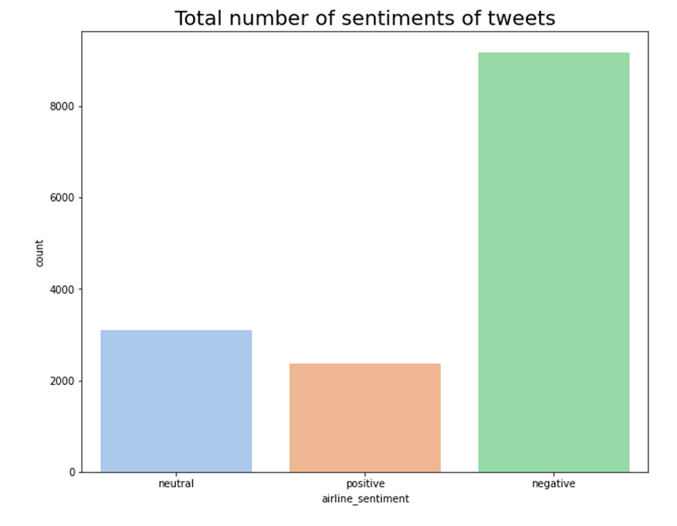
2. Total Number of Sentiments of tweets
From 14000 tweets, negative sentiment has the highest number of tweets followed by neutral and positive.

Slide 7
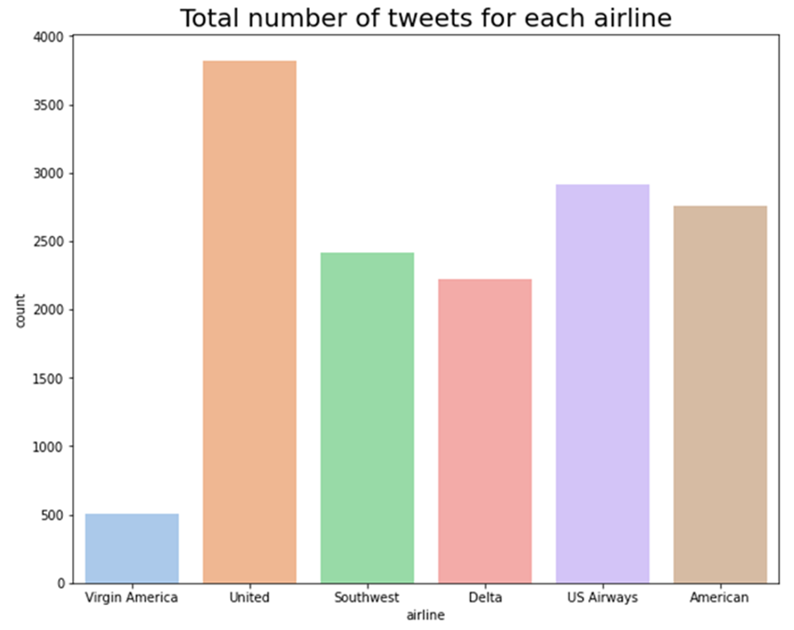
3. Total Number of tweets for each airline
The tweets for United Airlines are the highest whereas Virgin America has the lowest.

Slide 8
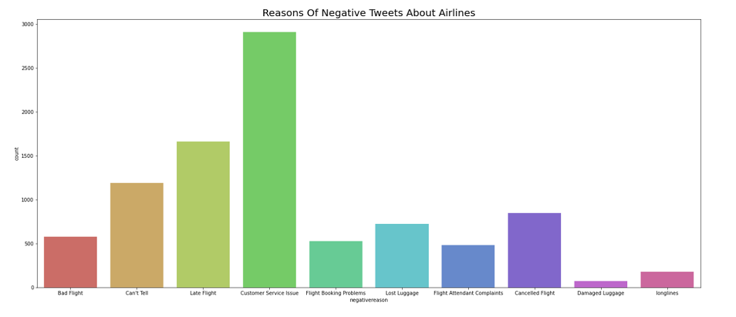
4.Reason for Negative Tweets about Airlines
Customer Service is the main issue for negative tweets about airlines. The issues about the flight has not been much of an issue for the travellers whereas luggage of the travellers is seemed to be the least worry.

Slide 9
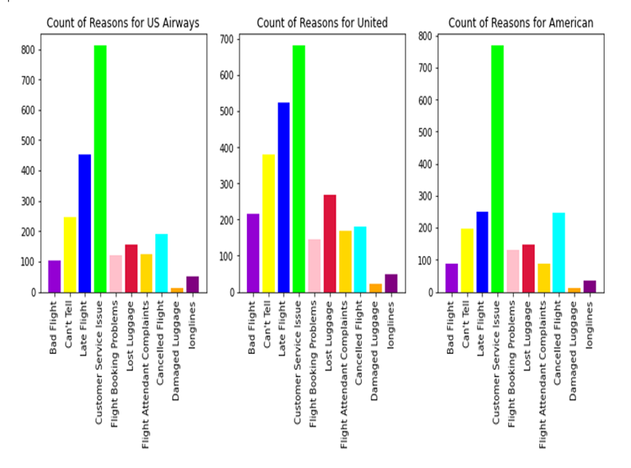
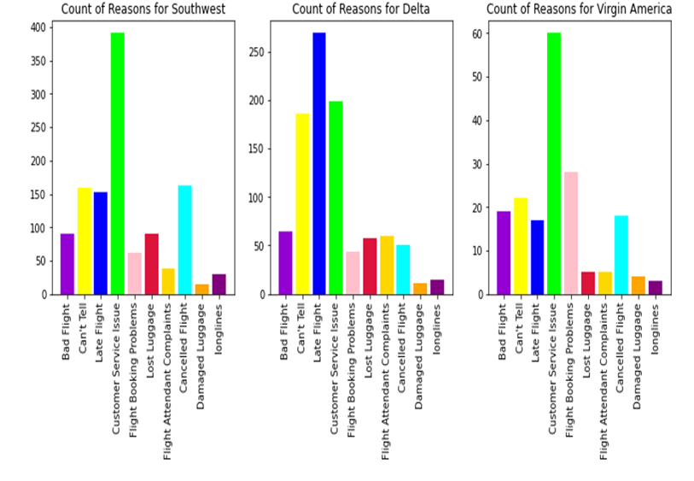
5.Negative Reason for each airline
As we said earlier, the customer service issue is the main problem for all the airlines. Apart from that late flight issue is also one of the major reason for Delta and United Airlines.

Slide 10
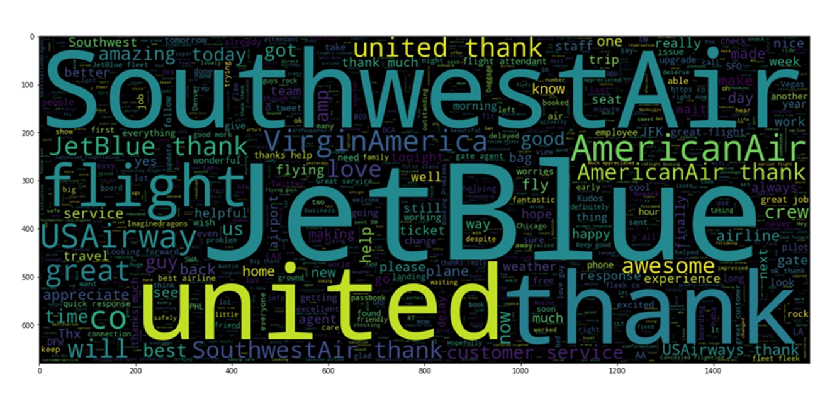
6. Word clouds
A word cloud is a cluster, or crumble of words depicted in different sizes. The bigger and bolder the word appears, the more often it is mentioned in the given text.
POSITIVE SENTIMENTS:-

Slide 11
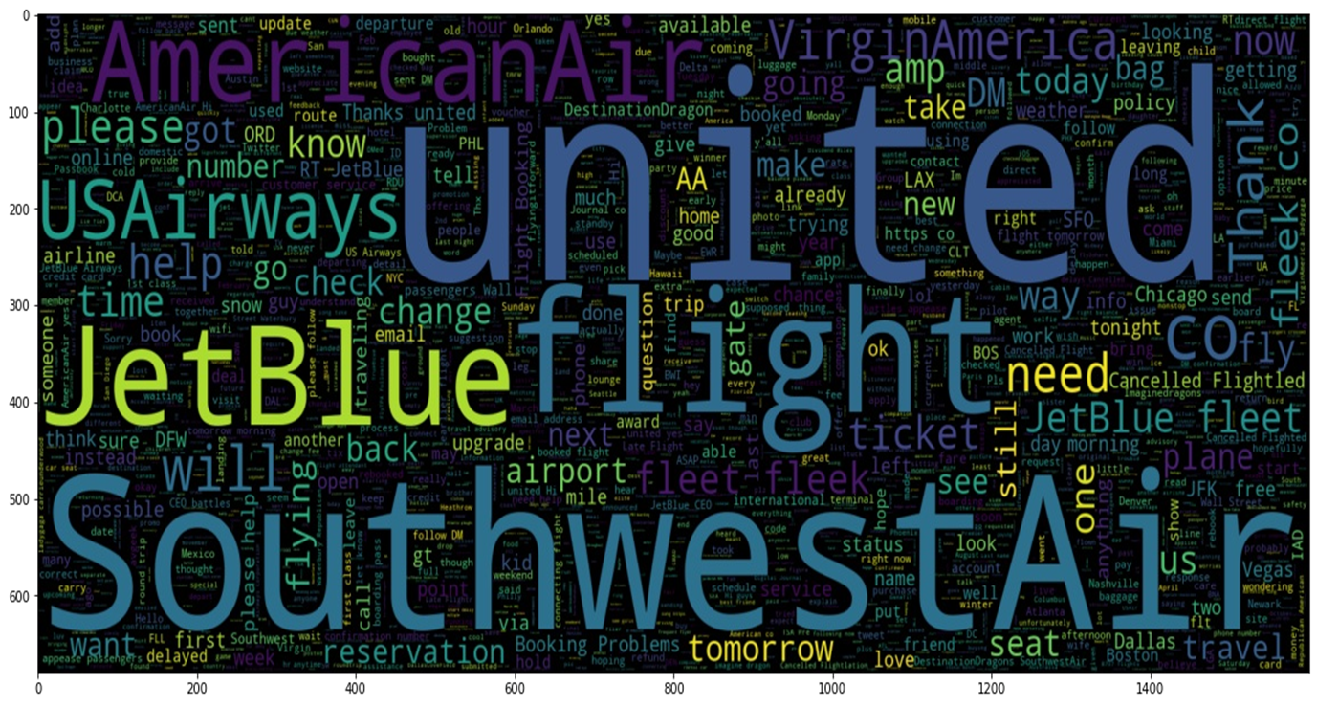
NEUTRAL SENTIMENTS:-

Slide 12
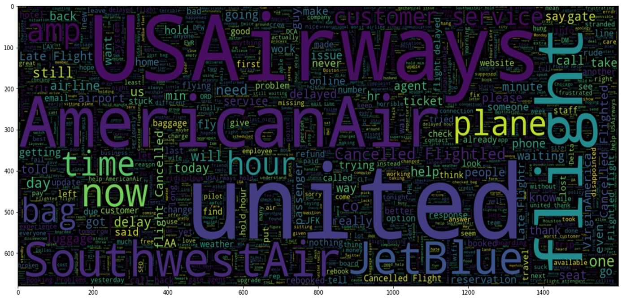
NEGATIVE SENTIMENTS:-

Slide 13
DATA PRE-PROCESSING:-
Making the text lower case.
Removing the stop words from the text.
Removing the punctuations.
Removing the emojis.
Decontracting words.
Separating alphanumeric words.

Slide 14
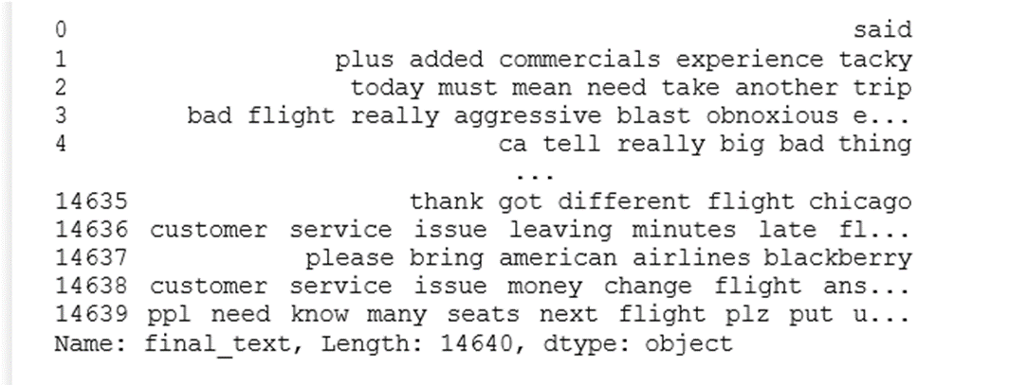
Text After Preprocessing:-

Slide 15
MODELS:-
1.Logistic Regression:-
Logistic Regression is a linear model that is used when observations must be assigned to a discrete set of classes.
For sentiment analysis, it can help predict the by probabilistically assigning them to one of the three classes (positive or negative or neutral).
In order to map the predicted outcomes to the classes, it uses a sigmoid function. Using this model for sentiment analysis is advantageous as it is a simple classifier that can train fast.
In this model we are using L2 regularization(Ridge Regression)

Slide 16
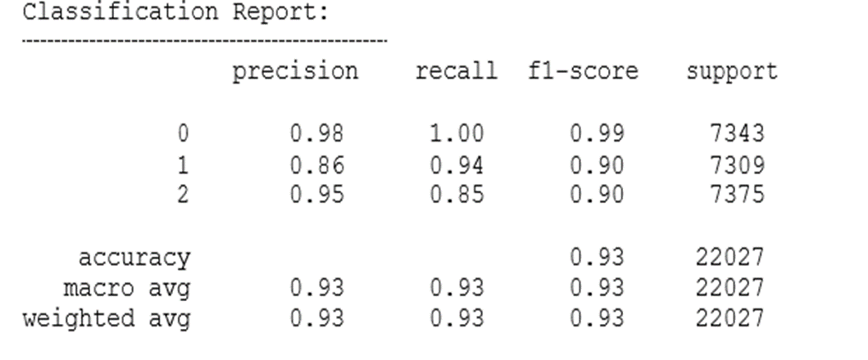
Training Data:

Slide 17
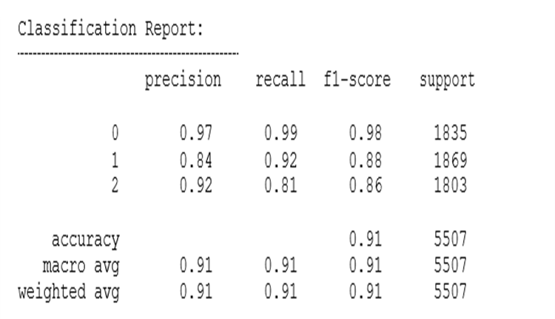
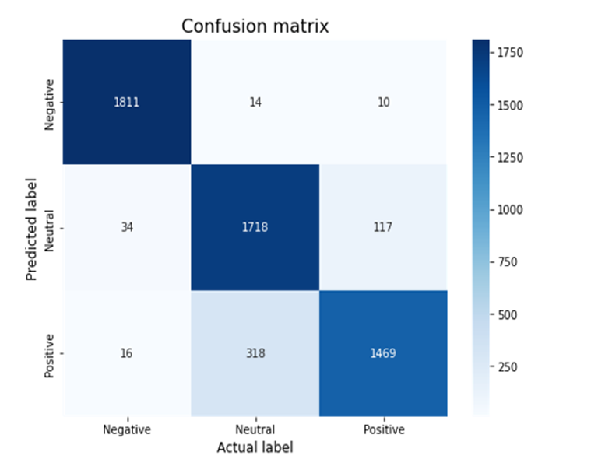
Testing Data:
The logistic regression model has been trained with L2 Regularization and the model has achieved an accuracy of 90.6% on the testing data. Other metrics computed for training and testing are shown in the figures respectively.

Slide 18
2.Naive Bayes :-
Multinomial Naïve Bayes belongs to the family of Naïve Bayes Classifiers and has been implemented to classify the reviews as either positive or negative or neutral. These classifiers return an estimate of the dependent variable by using the probabilities computed for independent variables. Naive Bayes works by assuming that the features are uncorrelated or independent as compared to other features.
It uses the Bayes Theorem for unknown class prediction. Naive Bayes classification technique is simple and powerful.Naive Bayes is a very good type of prediction when used with text data.

Slide 19
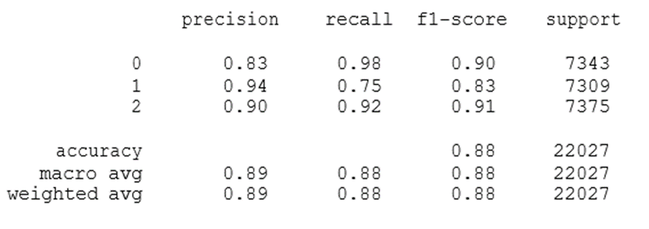
Training Data:

Slide 20
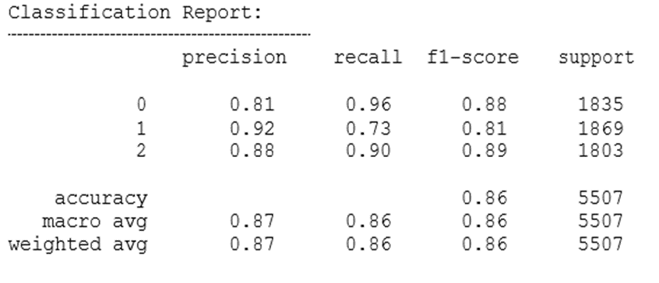
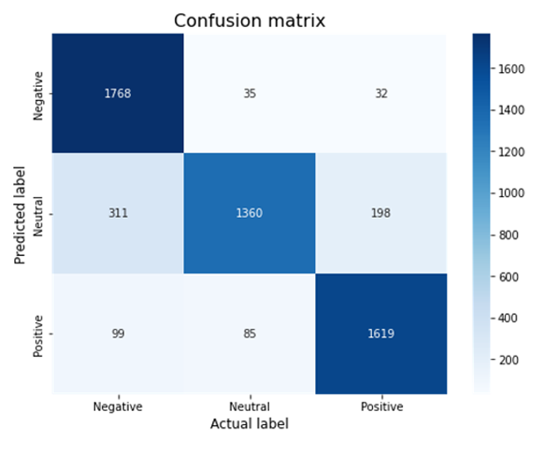
Testing Data:
By implementing multinomial Naive Bayes algorithm we got an accuracy of 86.1% on the test data.

Slide 21
3.Support Vector Machines:-
The Support Vector Machine method is a statistical classification approach which is based on the maximization of the margin between the instances and the separation hyper-plane.
Support Vector Machine (SVM) is a relatively new technique for making predictions, both in classification and regression. Its implementation must have a training stage using SVM sequential training and followed by the testing phase.
The concept of classification with the Support Vector Machine is to find the best hyperplane that functions as a separator of three data classes. The Support Vector Machine can work on high-dimensional datasets using kernel tricks.
The Support Vector Machine only uses a few selected data points that contribute (support vector) to form a model used in the classification process.

Slide 22
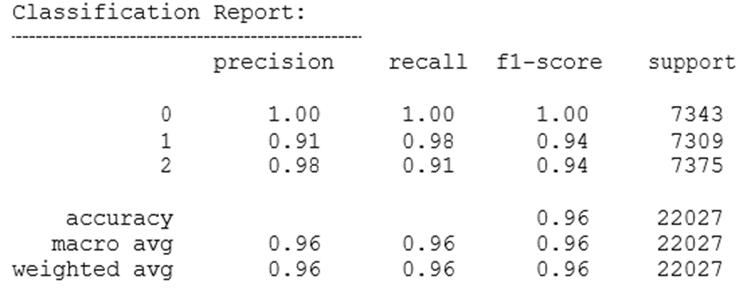
Training Data:

Slide 23
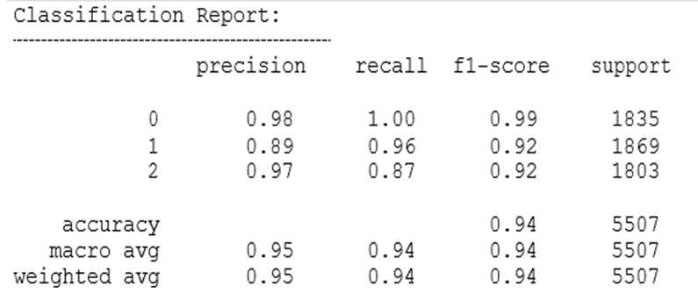
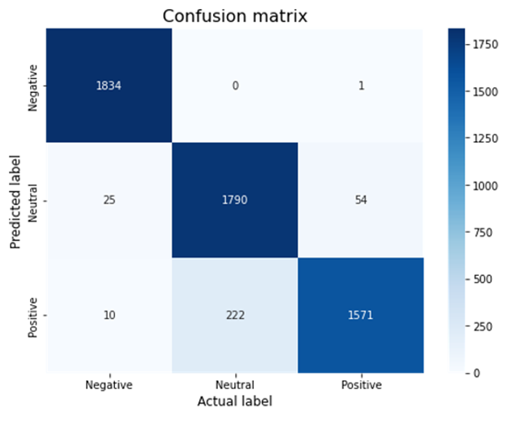
Testing Data:
As it can be observed, the model has achieved an accuracy of 93.5% which is very good. The precision and recall values are also high.

Slide 24
4.Decision Trees:-
The decision tree is a method of classification and pattern prediction from data. It describes the relationship of the attribute variable x and target y in the form of a tree. The decision tree has a structure like a flowchart, where the internal node is a test of the attribute variable (not the leaf / outermost), each branch is the test result, and the outer node is the leaf, which is the label.

Slide 25
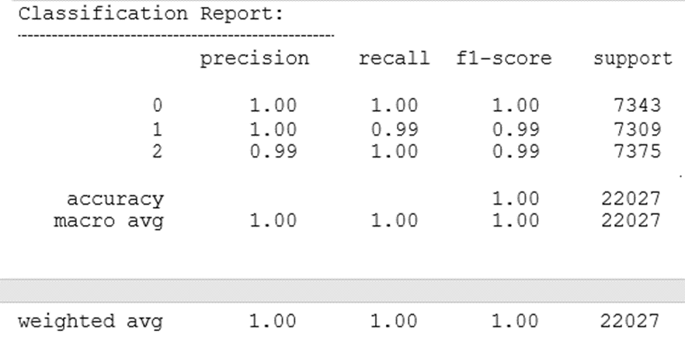
Training Data

Slide 26
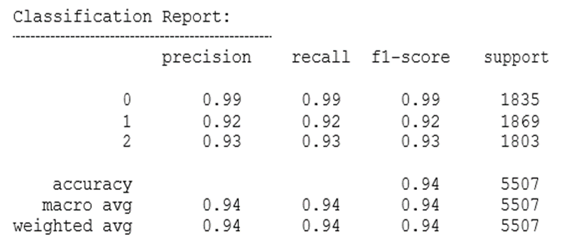
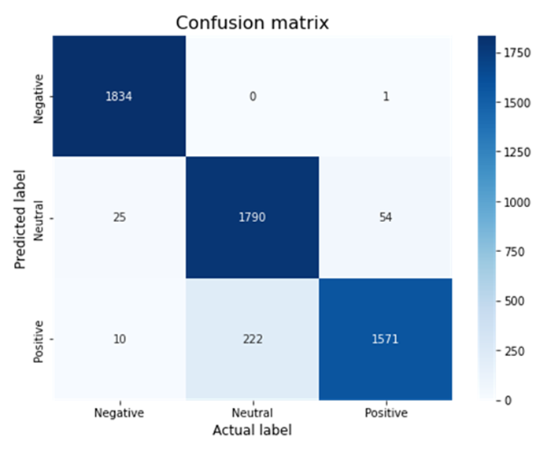
Testing Data

Slide 27
5.Random Forest:-
Random Forest (RF) is a classification algorithm that can be used to identify sentiment analysis and emotion analysis in numbers significant data. Random forest is an ensemble learning method that construct a number of decision trees at randomly selected features and predict the class of a test instance by voting of the individual trees.
A Random Forest is a meta estimator that fits the number of classifying decision trees and various sub-samples of dataset and uses averaging to improve the predictive accuracy and control overfitting.

Slide 28
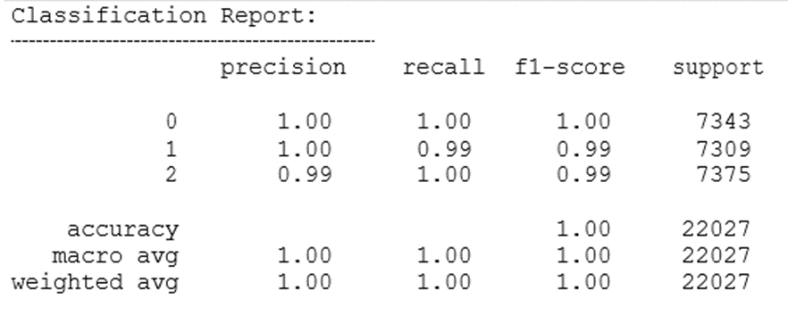
Training Data

Slide 29
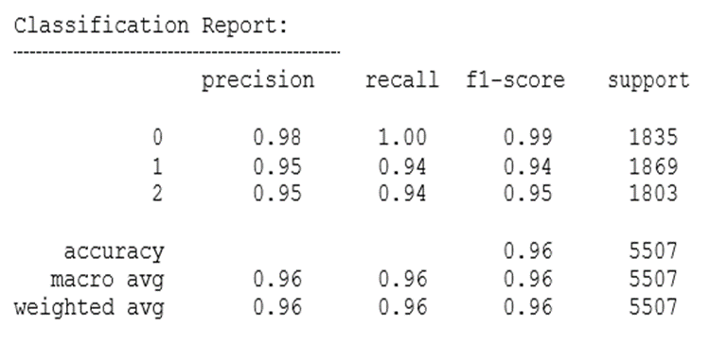
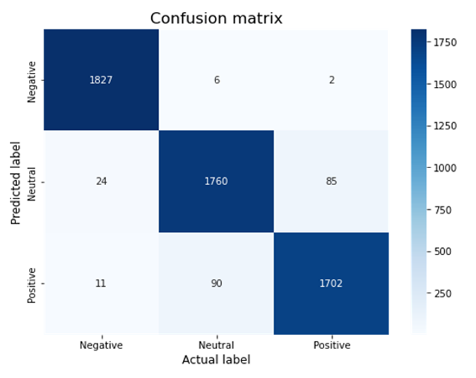
Testing Data
We got the highest accuracy for the random forest which is 95.5%. Compared to other models this is the best fit.

Slide 30
EXPERIMENTS AND EVALUATIONS:-
The proposed work is analyzed by using Machine Learning algorithms called Random Forest, SVM, Logistic Regression, Naive Bayes and Decision Trees. In our system the accuracy, precision, F-1 Score and recall are calculated for all algorithms and then accuracy comparison is made using these algorithms. In which the Random Forest gives the best accuracy of about 95.6% than the Support Vector Machine which is around 93.5%.

Slide 31
RESULTS:-
The data is pre-processed to obtain clean data for further processing. This process fully uses the Python programming language. Classification result data was carried out using three data groupings, namely negative, positive and neutral.
The process begins by reading the data and then preprocessing. Preprocessing aims to clean data. The resulting data is a core that has no noise. This process is carried out with several processes, including: filtering (slank word conversion, remove the number, remove stopword, remove the figure, remove duplicate), emoticon conversion. In the conversion process, emoticons have rules to improve data cleanliness. This process is a preprocessing, which is processed in full by coding using Python. The final result of this preprocessing is clean data. Result data is data that has meaning for the next process. The preprocessing eliminates meaningless/useless text.

Slide 32
THANK YOU!

